Slide 1
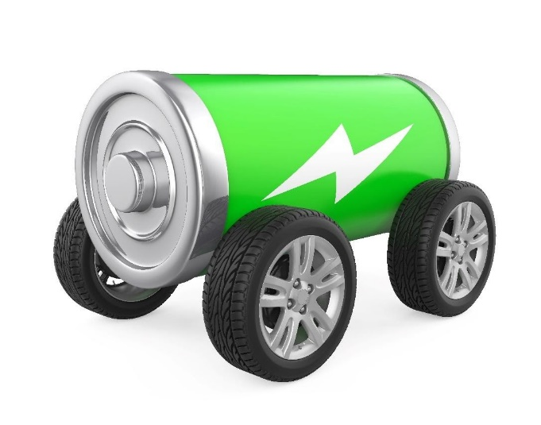
INTRODUCTION TO GEARS & GEAR RATIOS
Brought to you by:
Electric Vehicle Challenge

Slide 2
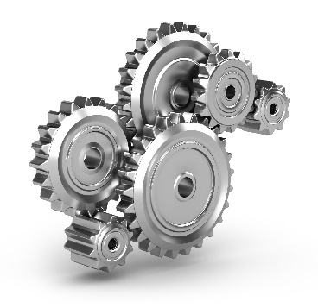
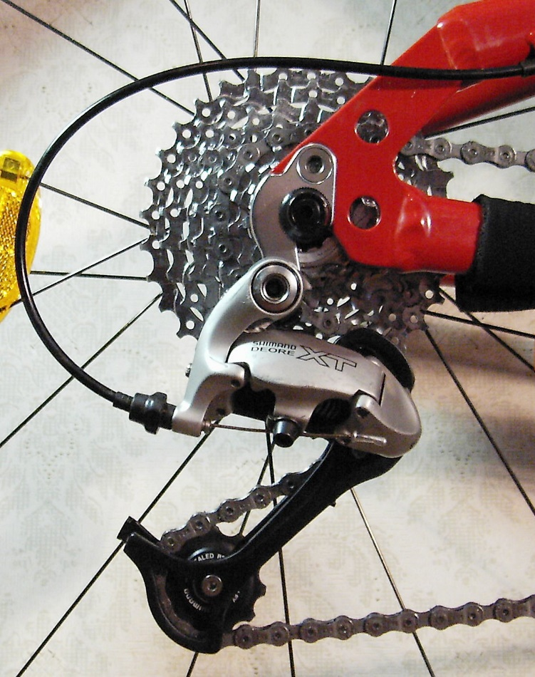
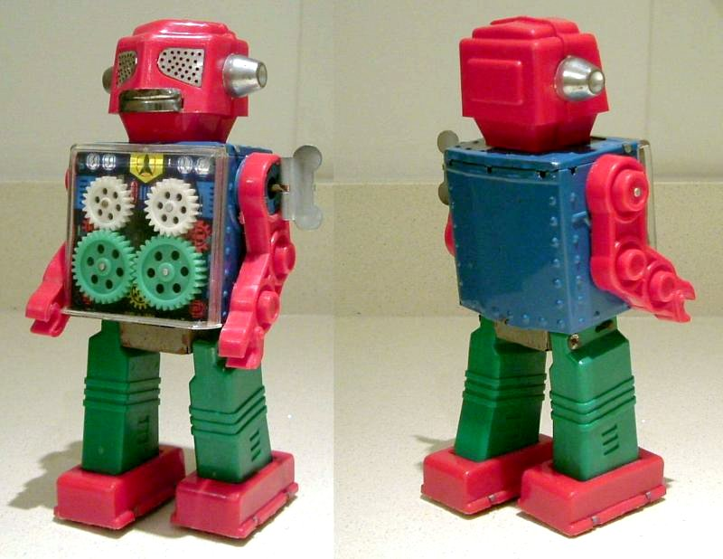
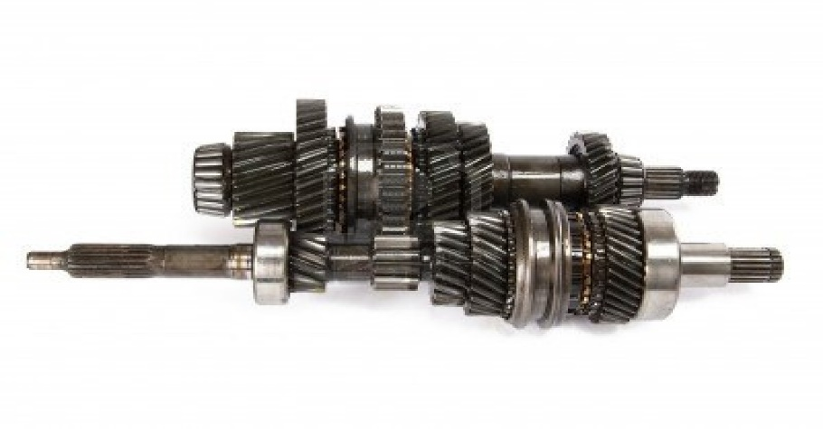
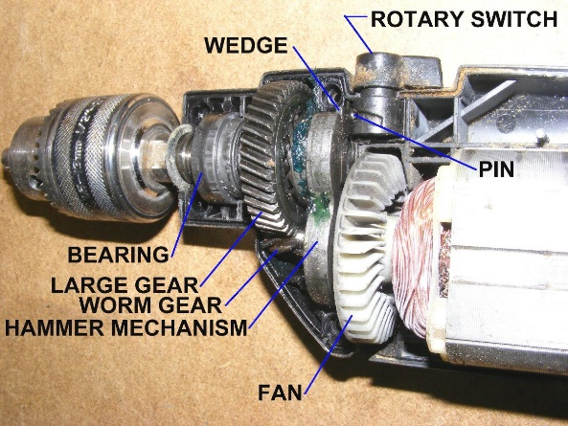
WHAT IS A GEAR?
A gear is a wheel usually made of metal or plastic with teeth that meshes together with other gears to transfer rotational energy
Watch/
Clock
Wind-up
Toys
Drill
Bicycle
Vehicle Transmission

Slide 3
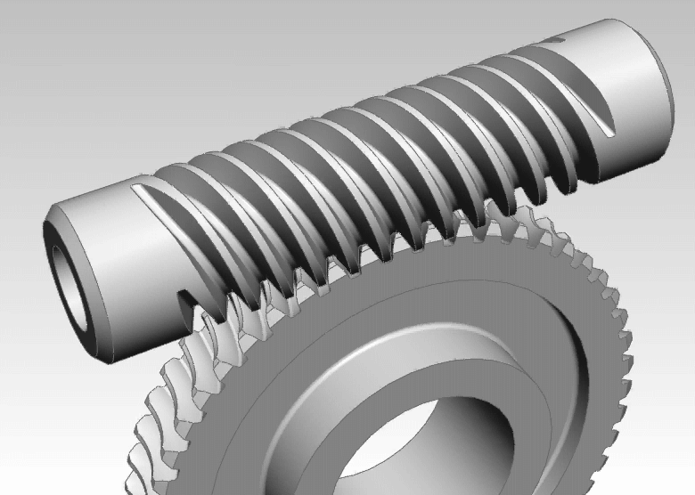
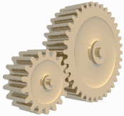
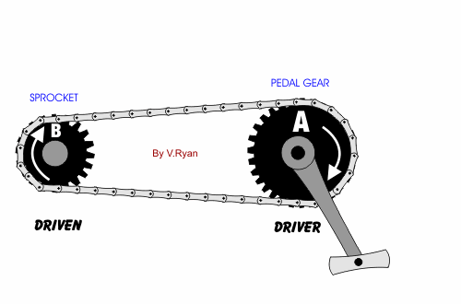
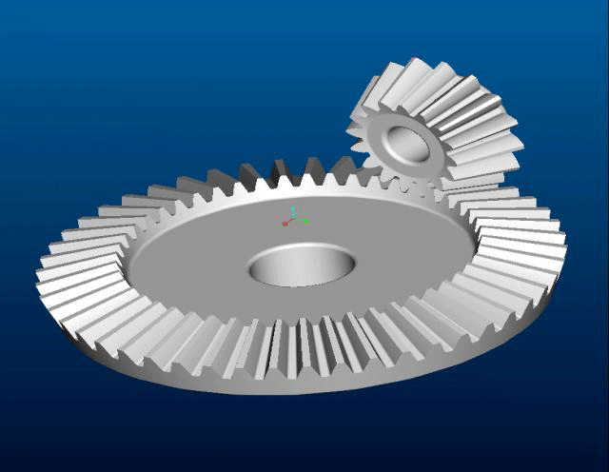
DIFFERENT TYPES OF GEARS
Worm Gears
Spur Gears
Pulley Gears
Bevel Gears

Slide 4
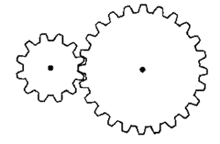
GEAR RATIOS
What is a Ratio?
The number of times one number can be found within another.
Example: There are three 2’s in six [6/2 =3]
What is a Gear Ratio?
A Gear Ratio is the number of times a gear will turn in full when compared to another gear
2
:
1

Slide 5
FINDING GEAR RATIOS TWO GEARS
Driver Gear
Driven Gear

Slide 6
FINDING GEAR RATIOS COUNT THE TEETH ON EACH GEAR
Driver Gear
Driven Gear
Driven Gear
Driver Gear

Slide 7
FINDING GEAR RATIOS DIVIDE ONE TEETH COUNT BY THE OTHER
Driver Gear
Driven Gear

Slide 8
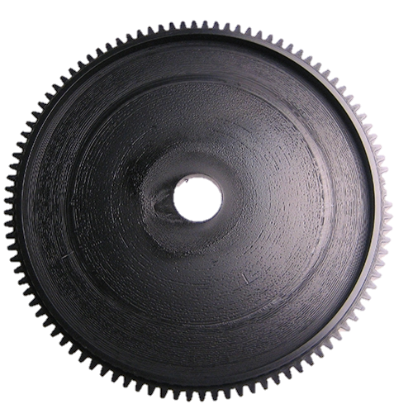
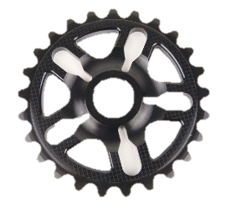
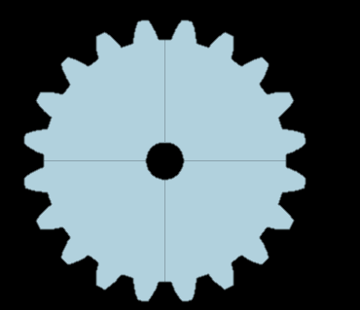
LET’S GIVE IT A TRY! WHAT ARE THE RATIOS OF THESE GEAR COMBINATIONS?
1
Driven Gear
Driver Gear
Driven Gear
3
40 teeth
40 teeth
Driver Gear
1
/
1
Driven Gear
2
100 teeth
25 teeth
Driver Gear
4
/
1
40 teeth
20 teeth
2
/
1

Slide 9
TORQUE VS. SPEED
What is torque?
Torque is a measure of the force needed to get an object to rotate
What is speed ?
Speed is how fast your gears are spinning.
*Rotations per Minute (RPM)
Torque and speed are relative to one another when comparing them with the output power of the motor.
POWER = Torque * Speed

Slide 10
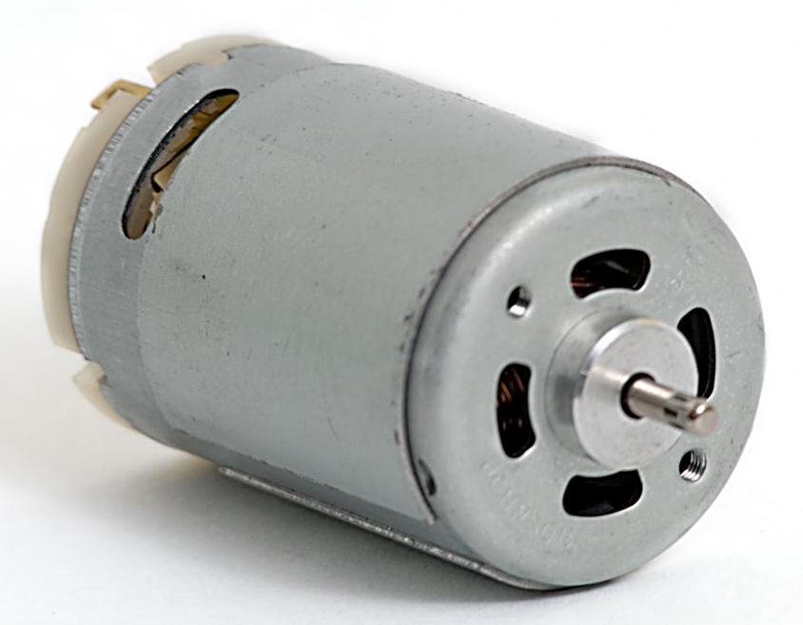
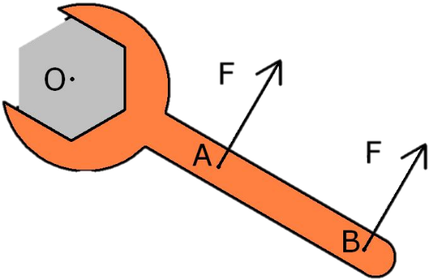
TORQUE VS. SPEED (CONT.)
What happens when you change the speed or the torque?
POWER = Torque * Speed
=
*
Torque
(5.5 N-m)
Speed
(2000 RPM)
Power Output
(1150 W)

Slide 11
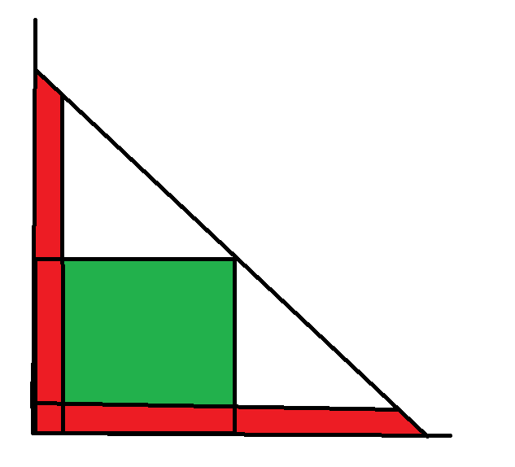
Stall Torque
12.7 N-m for our motor
Max Power
Torque
No Load Speed
5,200 rpm for our motor
Rotational Speed

Slide 12
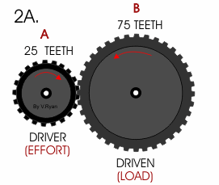
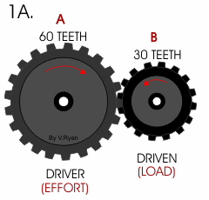
LET’S GIVE IT A TRY! WHICH ONE OF THESE WILL GIVE YOU MORE TORQUE AND WHICH ONE WILL GIVE YOU MORE SPEED?
Torque
Speed

Slide 13
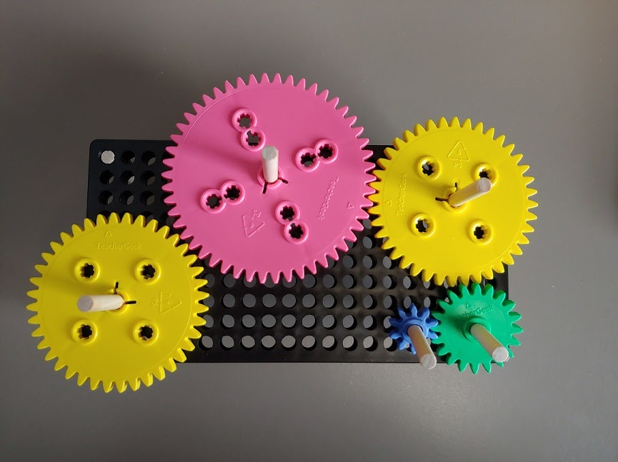
GEAR RATIO LAB SETUP
50-tooth gear
40-tooth gear
20-tooth gear
40-tooth gear
10-tooth gear

